Slide 1



Linear array of stacked patch antennas for intelligent food shelves
Wireless Electromagnetic Technologies
Aa 2024/2025
S.Gialloreto, V.Luzi, M.Barracu

Slide 2

Application Context
Manual Implementation
Interaction with AI
Comparisons

Slide 3
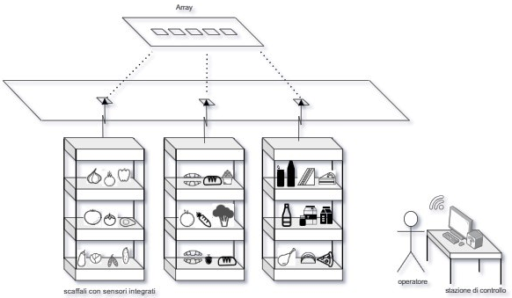
Application context
Objective
Food sustainability
Measured property
ɛr as an index of deterioration
Food shelves
-Integrated sensors
Linear array
Control Station
-Monitoring

Slide 4
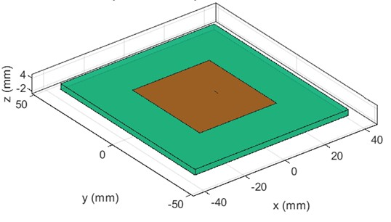
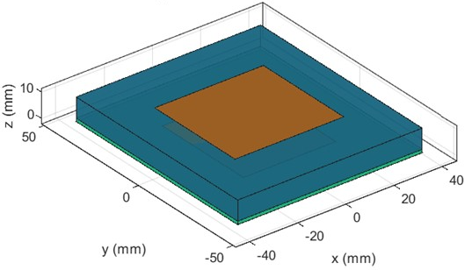
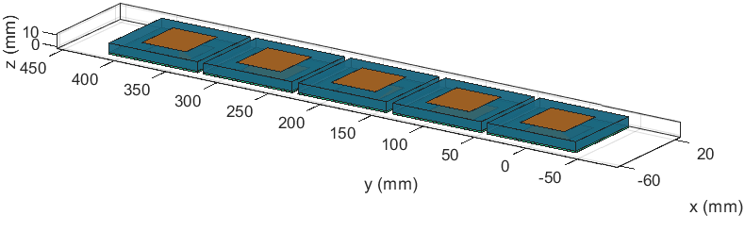
Manual Implementation
Patch
Low profiling
Adaptability
Stacked
Increase in BW
Array
Increase in gain
Increase in directivity
Facilitated impedance matching

Slide 5
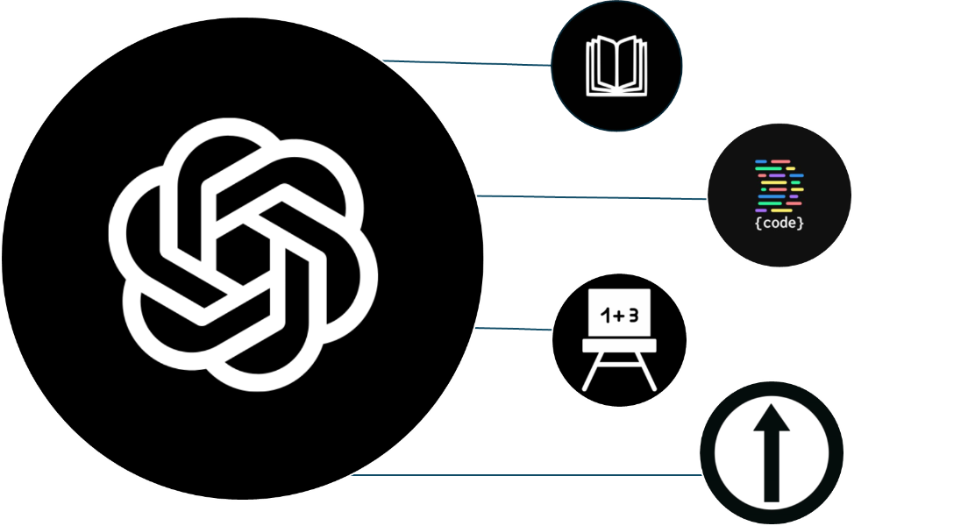
Interaction with AI
Research
Coding
Parameters
Guidelines

Slide 6




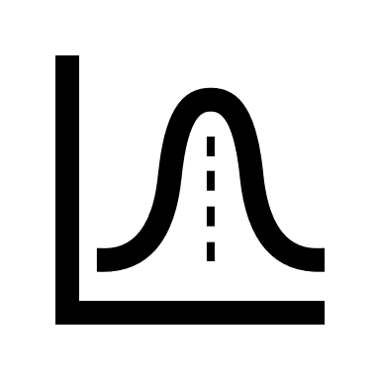

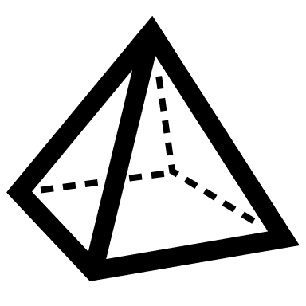


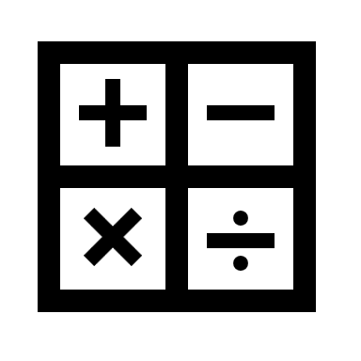



Workflow
Analogies
Differences
-Patch geometry
-S11
-Mesh optimization
-Resonance
-Optimized patch
-Array synthesis
-Optimization of the top patch
-Interpretation of results
-Learning from experience
-Calculation speed

Slide 7
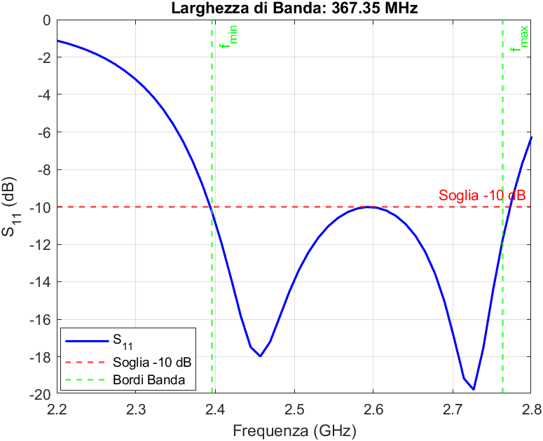
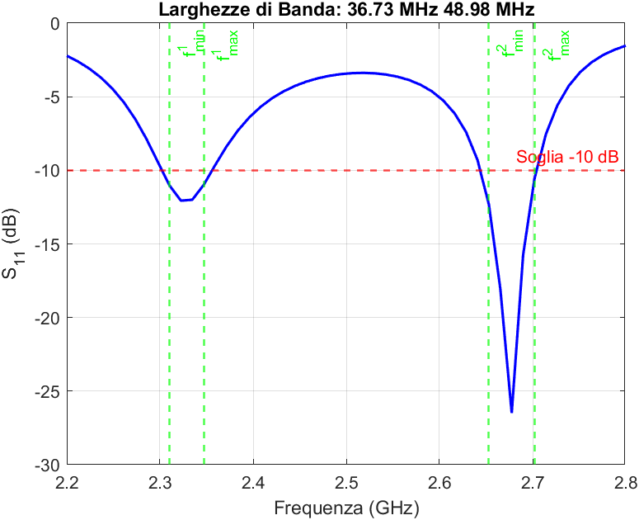
Comparison of Results
 | Parameter | Manual value | AI value
Patch | S11 | -16dB | -9dB
 | Impedence | X=8Ω, R=40Ω | X=25Ω, R=4Ω
 | BW | 50MHz | --
Stacked | Dip | -10 | -3
 | BW | 320MHz | --
Array | Gain | 8,74dB | 2,90dB
 | Directivity | 15dB | 10dB
 | Efficiency | 60% | 29%

Slide 8
Pros and cons of AI
Pros
Speed
Interactivity
Cons
Unreliable scientific data
Incorrect MATLAB codes
Overaccomodating attitude
Unreliable planning

Slide 9





Conclusions
Currently, AI must be used critically and supported by prior knowledge.

Slide 10
Thank you for your attention

